Slide 1
Introduction to OOP Md. Alamgir Hossain Lecturer, Dept. of CSE, State University of Bangladesh Mail: alamgir.cse14.just@gmail.com YouTube: https://www.youtube.com/alamgirhossaincse Blog: https://alamgirhossainjust.blogspot.com/

Slide 2
Programming Techniques (Unstructured)
A programming language in which the entire logic of the program is written as a single continuous (nonstop or unbroken) block is called ”unstructured Programming”.
Program written by following this language is very difficult to modify and to debug.
Example: Assembly Language Programming

Slide 3
Programming Techniques (Structured)
A programming language in which the entire logic of the program is written by dividing it into smaller units or modules is called ”structured programming Language”.
In C, the smaller units are referred to as functions.
A function is written separately to perform a specific task.
Each function has a unique name.
It is called for execution in the main body of program with reference to its name.
Program written in structured programming language is very easy to modify and to debug.
Today, the most popular and commonly used structured programming language is C language.

Slide 4
Programming Techniques (OOP)
Object-oriented programming (OOP) is a software programming model constructed around objects. In this way, the data structure becomes an object that includes both data and functions.
In addition, programmers can create relationships between one object and another. For example, objects can inherit characteristics from other objects.
Many of the most widely used programming languages (such as C++, Java, Python, etc.)

Slide 5
Difference between Procedural Programming and OOP
PROCEDURAL ORIENTED PROGRAMMING | OBJECT ORIENTED PROGRAMMING
In procedural programming, program is divided into small parts called functions. | In object oriented programming, program is divided into small parts called objects.
Procedural programming follows top down approach. | Object oriented programming follows bottom up approach.
There is no access specifier in procedural programming. | Object oriented programming have access specifiers like private, public, protected etc.
Adding new data and function is not easy. | Adding new data and function is easy.
Procedural programming does not have any proper way for hiding data so it is less secure. | Object oriented programming provides data hiding so it is more secure.
In procedural programming, overloading is not possible. | Overloading is possible in object oriented programming.
In procedural programming, function is more important than data. | In object oriented programming, data is more important than function.
Procedural programming is based on unreal world. | Object oriented programming is based on real world.
Examples: C, FORTRAN, Pascal, Basic etc. | Examples: C++, Java, Python, C# etc.

Slide 6
Why Object-Oriented Programming
Objects are modeled on real world entities.
It provides data hiding.
Provides reusability of code through inheritance.
Provides flexibility through polymorphism.
OOP provides the effective problem-solving way.
Provides easy code maintenance.
OOP is faster and easier to execute.
OOP provides a clear structure for the programs

Slide 7
Features of OOP
Classes & Objects
Abstraction
Encapsulation
Inheritance
Polymorphism
Dynamic Binding
Message Passing

Slide 8
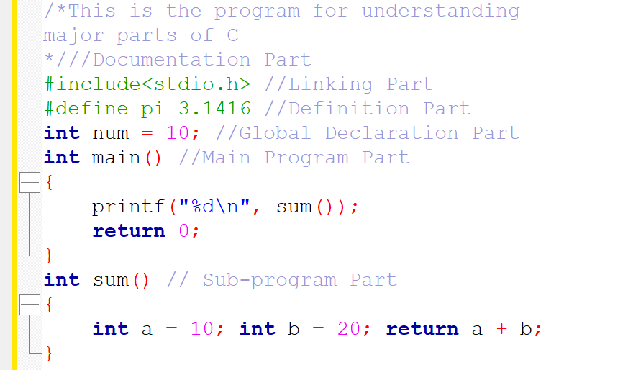
Major Parts of a C program

Slide 9
Homework
What is the main difference between the procedural oriented programming and object-oriented programming which is directly connected to change the real world? (Don't try to copy and paste, just write your opinion).

Slide 10
Thank You

